Slide 1
IPR Term 1 Week 9
Chi-square test
Dr Hayley Dewe
(Assistant Professor)

Slide 2
Announcements
MCQ in-class test
Next week Thursday 11th December 1-2pm
Bring a charged laptop with access to Ultra!!
Room: CLC013
Not permitted: phones out, talking, leaving early (you’ll be dismissed together), notes or other tabs/documents open
Students with accommodations:
Extra time: Mitigated already. Test should be able to be completed in 30 mins (regular time) leaving 20 mins for extra time
Smaller/own room: you will be emailed your arrangements beforehand (e.g. room number, staff member invigilating)
If you think you should have this room accommodation but haven’t received an email by Tuesday 9th, please email me and the office (with a copy of your DSP) by Tuesday 9th midday
Unable to provide accommodations if your DSP isn’t in place or we’ve not heard from disability support.

Slide 3
Learning Outcomes
Understand the purpose of the chi-square tests – when to use them
Know the difference between the goodness-of-fit and test of association and when to use them
How to calculate chi-square tests manually
Interpret the results of a chi-square test in the context of the research
Online content: Run the tests using JASP software using the ‘How to’ videos

Slide 4
Lesson Outline
Introduction to chi-square
Goodness-of-fit test
Test of association
Interpretation and write up
Online content: run the tests using JASP

Slide 5
Today
We’ll start looking at our first inferential statistics test
Different tests are used for different types of data
We use these tests to work out if there’s a ‘significant’ difference / effect between our data and the population (or a theoretical distribution) using hypothesis testing
For each test, we’ll learn what it is, when it’s used, how to run it (manually and via JASP), how to write it up and how to interpret the findings…
Each test also has ‘assumptions’ (requirements) to be met to run the test

Slide 6

Introduction to chi-square test

Slide 7
What is Chi-square?
Written as X²
Definition: an inferential statistical test to determine whether there is a significant association between nominal (categorical) variables.
Purpose: compares observed data (counts / frequencies) to expected frequencies under a specific hypothesis
E.g., or the frequency of occurrence (of a behaviour) between two categorical groups
Test Output:
- Calculates a test statistic χ2 which is then compared against a critical value to compare against a theoretical distribution –decision based on a critical value / p-value

Slide 8
What is Chi-square?
Types:
(depends on aim and how many variables you have)
Chi-square goodness-of-fit: if data fits a theoretical distribution
when you have one variable
Chi-square test of association: if two nominal variables are related
when you have two variables

Slide 9
Chi-square test
For both types of Chi-square test, it measures how far the data deviate from expectation (or from another variable)
Alternative hypothesis is always non-directional (does not specify a direction)
It doesn’t tell us about direction, or make any expectations on which group/condition is bigger or higher etc.
However, the test uses a one-tailed critical region in terms of its distribution, because χ² values are always positive
Larger values indicate greater deviation from the null hypothesis

Slide 10
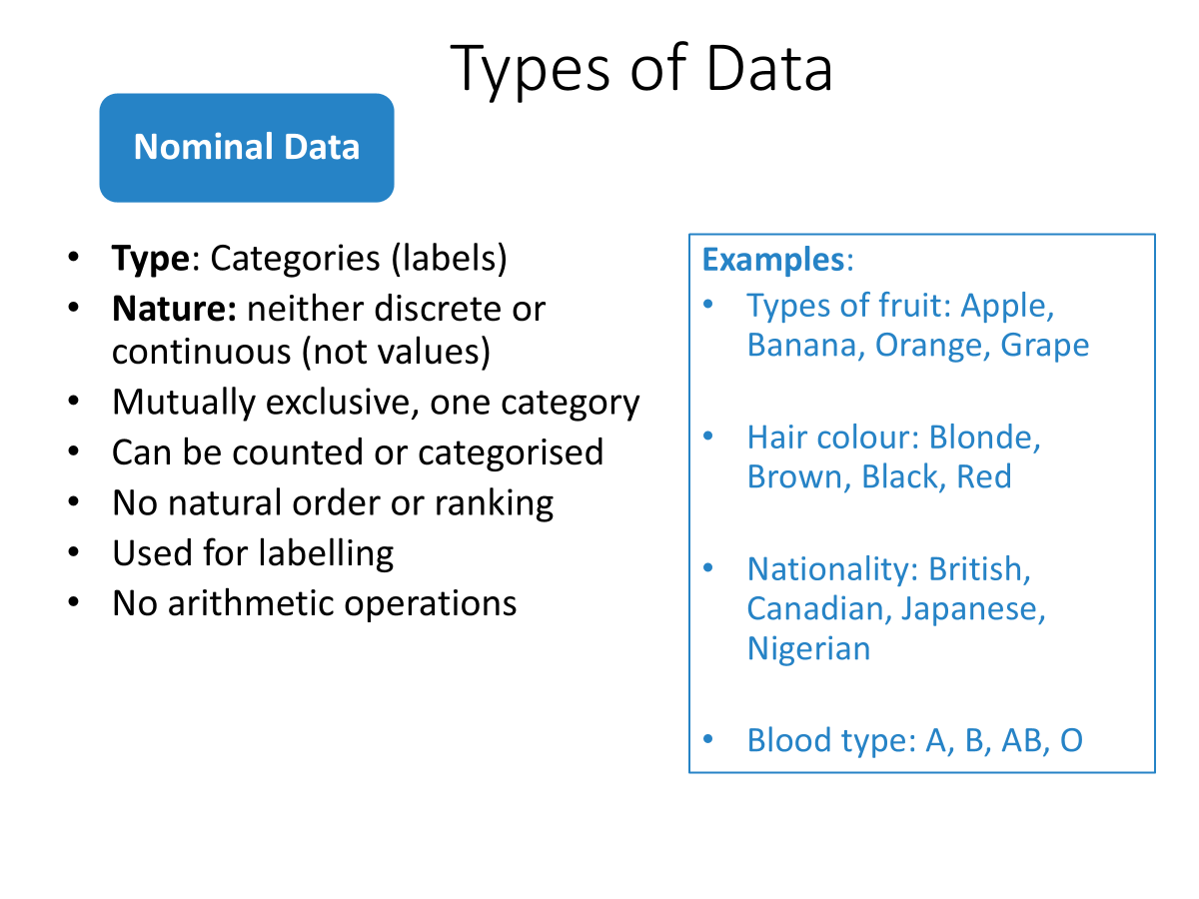
When to use Chi-square?
Nominal (categorical) data
One or two variables

Slide 11
Assumptions for Chi-square
1. Data Type: Nominal (categorical) variables
Type of data / level of measurement of all the variables should be nominal or ordinal (not continuous)
e.g., Hair colour, Political party
2. Mutual Exclusivity
Variables / categories should be mutually exclusive
Each participant, event, or item must contribute to only one category (one cell in the table). They must be independent.

Slide 12
Assumptions for Chi-square
3. Expected Frequencies
The Expected frequency for each cell should be 5 or more to ensure validity of the chi-square test
If any expected count is less than 5, a larger sample or Fisher's Exact Test may be more appropriate
A more relaxed guideline: at least 80% have a value of 5 >
Or no cell should have an expected frequency of 0

Slide 13

Assumptions for Chi-square
4. Independence of observations
Every observation in the dataset is independent. One observation does not affect the value of any other observation.
5. Random Sampling
Data from a random sample to ensure representativeness and avoid bias
Violating these assumptions can lead to inaccurate results, as the test relies on approximations that depend on these conditions

Slide 14
2. Chi-square goodness-of-fit test

Slide 15
Chi-square goodness-of-fit test
Tells you whether the overall distribution differs from what is expected
It does not tell you:
which category (or categories) caused the difference
the direction of the difference (e.g., which category is higher or lower than expected)

Slide 16
Goodness-of-fit: Example
Our research question is exploring participant’s favourite streaming service…
Is the frequency of favourite streaming services in our observed data (significantly) different to the frequency you would expect randomly?
We can develop a hypothesis…
Remember the test tell us whether the Observed frequency is different or not from the Expected frequency (i.e. a yes or no answer). It doesn’t give the direction or make expectations on which group/category is closer/further away from expected.

Slide 17




Goodness-of-fit: Example
We asked 180 people their preferred (e.g. most used) streaming service platform. 1 variable: Streaming platform (3 x groups)
Random Sample: 180 people

Slide 18
Hypothesis for Chi-square
Null Hypothesis (H₀)
Alternative Hypothesis (H₁)
There will be no effect or relationship
There will be an effect or relationship
e.g. There will be no difference in the frequencies of the three streaming platforms
i.e., expected and observed values the same
e.g., There are differences in the frequencies between the three streaming platforms
i.e., expected and observed values will differ

Slide 19


Goodness-of-fit: Example
60 people
60 people
60 people
Expected Frequency: frequency that occurs in the data set.
Frequency we would predict if belonging to each category were random

Slide 20


Goodness-of-fit: Example
50 people
30 people
100 people
Observed Frequency: frequency that occurs in the data set.
Frequency that occurs in the data set, i.e., are our values significantly different to random (no preference)

Slide 21
Goodness-of-fit: Example
Participant’s favourite streaming service…
Frequency table
 | Prime Video | Disney+ | Netflix
Expected | 60 | 60 | 60
 | Prime Video | Disney+ | Netflix
Observed | 50 | 30 | 100
Note: for this type of Chi-squared test, it’s called a Frequency table: count of frequency in each cell
Run Chi-square goodness-of-fit test to get a test statistic (X²) in JASP and associated p-value

Slide 22
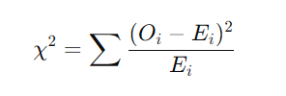
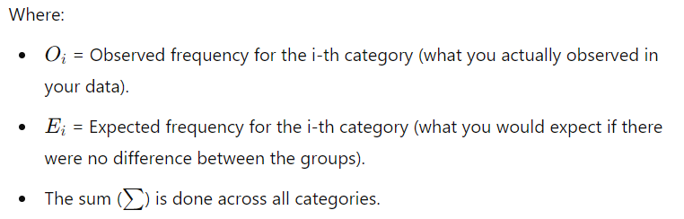
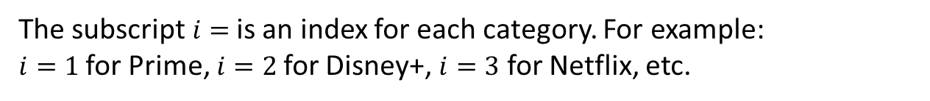
Calculating Chi-square goodness-of-fit
Calculate Chi-square goodness-of-fit by hand!
The subscript $i=$is an index for each category. For example: $i=1$for Prime, $i=2$for Disney+, $i=3$ for Netflix, etc.

Slide 23
Calculating Chi-square goodness-of-fit
 | Prime Video | Disney+ | Netflix
Observed | 50 | 30 | 100
1. O: Observed data
2. E: Expected data
(total number of participants
divided by number of categories)
3. (O – E): Calculate difference (called residuals)
4. (O – E)²: square the residuals (make it positive)
5. (O – E)² : Divide the squared residuals by Expected data
E
6. Repeat for all categories and Sum (∑) them
X² ⁼ chi-square statistic
 | Prime Video | Disney+ | Netflix
Expected | 60 | 60 | 60

Slide 24
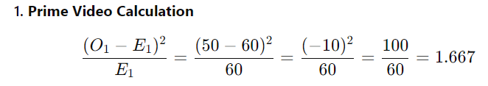
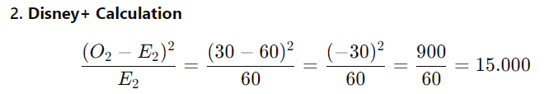
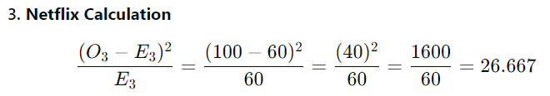


 | Prime Video | Disney+ | Netflix
Observed | 50 | 30 | 100
Expected | 60 | 60 | 60

Slide 25
Calculating Chi-square goodness-of-fit
So, what does this mean? Is this noteworthy?
Larger X² = greater difference between observed and expected frequencies
(it indicates greater deviation from the null hypothesis - from the expected distribution)
Smaller X² ⁼ smaller difference between observed and expected frequencies
But…
How do we know if it’s big or small?
Is the difference large enough to be ‘significant’?
Can we reject our null hypothesis?

Slide 26
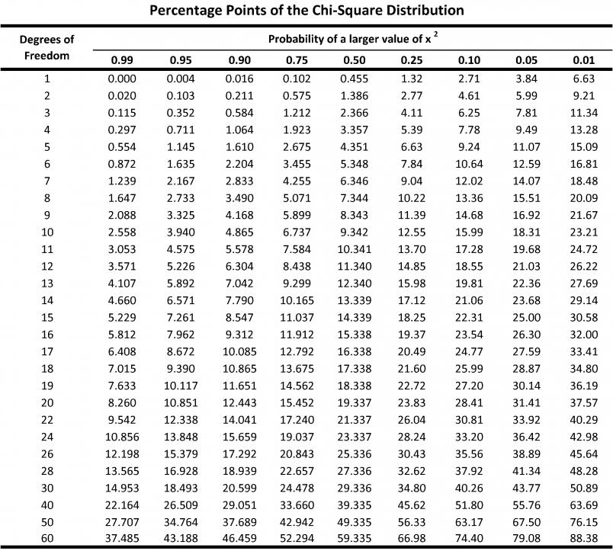
Remember all test-statistics come with a p-value. And for a manual calculation, you would look it up in a Critical value table
Compare calculated χ² statistic to the critical value in the table. The one associated with your df* and chosen significance level (α = 0.05)
If χ² > critical value → reject the null hypothesis
If χ² ≤ critical value → fail to reject the null hypothesis.
*df = degrees of freedom is the number of categories – 1. Represents how much data (room) is available to estimate parameters or test your hypothesis.

Slide 27
Test! Is our streaming platform result significant?
α = 0.05
Df = 2

Slide 28
But what happens when you have more than one variable?
Run a Chi-square test of association…

Slide 29
3. chi-square Test of Association
(or test of independence)

Slide 30
Chi-square Test of Association
Tells you whether there is a significant association between two categorical variables overall
It does not tell you:
where the difference is – i.e., which specific cells contribute most to the association
the direction of the difference or relationship (e.g., which category is higher or lower than expected)

Slide 31
Think back to our example of participant’s favourite streaming service…but imagine we also want to know if this preference is associated with their living location…
Here, we now have two variables:
1. Participant’s favourite streaming service…
2. Their location
We can create our hypothesis…
Remember the test tell us whether there is a relationship (association) between two categorical variables (i.e. a yes or no answer). It doesn’t tell us the direction, or which specific cells contribute most to the association.

Slide 32



Test of Association: Example
We asked 180 people their favourite streaming platform service and their location. 2 variables: Streaming platform (3) and Location (2)
Durham
London
Durham
London
Durham
London
Random Sample: 180 people

Slide 33
Hypothesis for Chi-square
Null Hypothesis (H₀)
Alternative Hypothesis (H₁)
There will be no effect or relationship
There will be an effect or relationship
e.g. No association between location and streaming platform choice. i.e., no relationship, they are independent.
e.g., There will be a difference in preferred streaming platforms that is associated with location. We expect a significant association between location and streaming preference

Slide 34
Test of Association: Example
Calculate Chi-square test of association by hand!
Remember for a goodness-of-fit test we calculated our Expected values by just splitting it equally?
Well, we don’t do this for Chi-square test of association!
We must calculate expected values first – then carry on with the chi-square analysis!
Expected frequencies depend on the marginal totals (row and column totals) in your contingency table, not on equal distribution.

Slide 35

Calculating Test of Association
Sum the Row and Column totals, to get the grand total (∑ )
(total number of observations in the data)
Contingency table
Contingency table
 | Location | Prime | Disney+ | Netflix | Row Total
Observed | Durham | 10 | 50 | 60 | 120
 | London | 10 | 20 | 30 | 60
Column Total |  | 20 | 70 | 90 | ∑ 180
Note: it’s called a Contingency table for this type of test

Slide 36
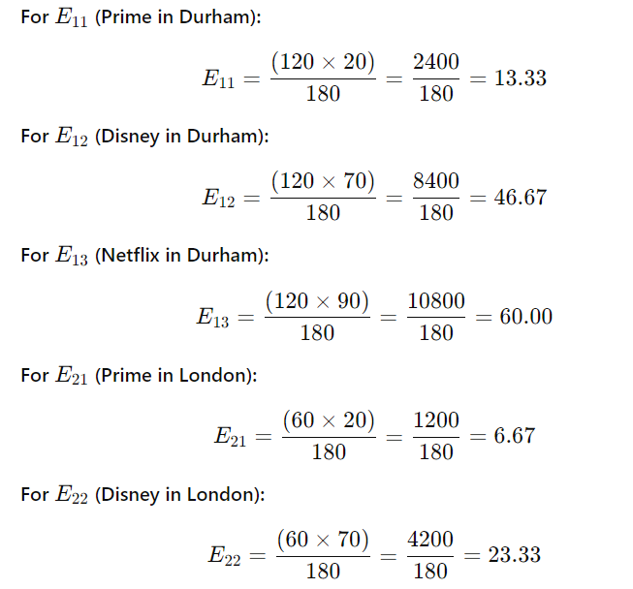
Calculating Test of Association
You calculate expected frequencies for each cell using the formula
 | Location | Prime | Disney+ | Netflix | Row Total
Observed | Durham | 10 | 50 | 60 | 120
 | London | 10 | 20 | 30 | 60
Column Total |  | 20 | 70 | 90 | ∑ 180
 | Location | Prime | Disney+ | Netflix
Expected | Durham | 13.33
 | London

Slide 37
Calculating Test of Association
Fill in your “Expected frequencies” Table

Slide 38

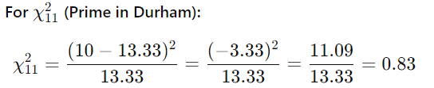
Calculating Test of Association
Once you have Expected values, you use the same formula as Goodness-of-fit to calculate the Chi-square test
And so on...
Then Sum all of them for your Chi²
Compares observed frequencies with new calculated expected frequencies – and same interpretation applies

Slide 39
Summary
How many variables?
Categorical Data (nominal)
One
Two
Chi-square goodness-of-fit
& Frequency Table
Chi-square Test of Association
& Contingency Table
Analyses frequencies across different categories within one variable
Analyses frequencies across different categories for two variables

Slide 40

But what happens if I have more than 2 variables…?
1. Participant’s favourite streaming service
2. Their location
3. Device (TV, laptop)
Contingency table
Platform | Device | Durham | Birmingham | London
Prime video | TV | 5 | 10 | 5
 | Laptop | 5 | 10 | 5
Disney+ | TV | 5 | 15 | 10
 | Laptop | 10 | 10 | 10
Netflix | TV | 15 | 15 | 5
 | Laptop | 15 | 5 | 5
Chi-square tests can only handle up to two variables (where each can have two or more categories/levels)
More complex analyses (not covered) e.g. logistic regression

Slide 41
4. Interpretation and write-up

Slide 42
Run the chi-square tests in JASP
Follow the “How to” JASP videos
(online content)
For either type of chi-square test, the JASP analysis output gives you a test statistic (X²) value and with it, it’s associated p-value for you to interpret
p-value = probability of obtaining this X² value (test statistic) assuming the Null Hypothesis (H₀) is true

Slide 43
RECAP: What is Significance?
Remember we’re testing a sample (from a population) to infer something about the population
Null hypothesis: no difference (between observed and expected frequencies)
Compare the calculated p-value to a set a threshold alpha level (𝛼), almost always 𝛼 = .05 (reduces the likelihood of making a Type I error)
And power (β) often = 80 (to reduce the likelihood of making a Type II error)
If p < α → reject the null hypothesis (there is some difference)
If p ≥ α → fail to reject the null hypothesis (insufficient evidence to conclude there is an effect)

Slide 44
Let’s look at the results of each test…
Our Goodness of Fit example (3 streaming preferences)
Our Test of Association example (3 streaming preferences and 2 locations)

Slide 45
1. Chi-square goodness-of-fit
One variable: streaming service (3 x categories)
 | Prime Video | Disney+ | Netflix
Observed | 50 | 30 | 100
 | Prime Video | Disney+ | Netflix
Expected | 60 | 60 | 60

Slide 46
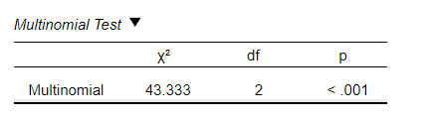
Test result: is it significant?
Look at the p value: is p < .05?
p < .001 is below p = .05, so the result is significant, reject the null hypothesis
= at least one category differs from the expected frequencies
Note the output here has a “<“ = p is below .001 (very small).
(FYI: if it output says ‘.000’ – you write it as p < .001)

Slide 47
Interpretation
Reject our null hypothesis and conclude there are differences in frequencies between streaming platforms
As p < .001, the probability of observing this result if the H₀ were true is less than 0.1%
Provides strong evidence against H₀ (we’ve found gold! Result is highly unlikely)
It’s significant, great. But remember this doesn’t tell you where/by how much…

Slide 48
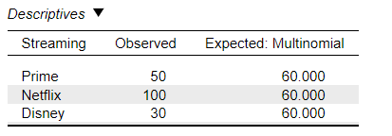
Interpretation
Go back to descriptives – where do the differences lie? What pair(s) is driving the effect? (JASP doesn’t have a post-hoc comparison test option)
Compare observed vs expected (output or descriptives).
You’d report these comparisons (table or text) and describe the differences.
<
>
<
Netflix has significantly more observed frequencies than expected. It’s likely Disney will be significant too.

Slide 49
2. Chi-square Test of Association
Durham
London
Two variables: streaming service (3 x categories) and Location (2 x categories)
 | Location | Prime | Disney+ | Netflix
Durham | Observed | 10 | 50 | 60
 | Expected | 13.33 | 46.67 | 60.00
London | Observed | 10 | 20 | 30
 | Expected | 6.67 | 23.33 | 30.00

Slide 50
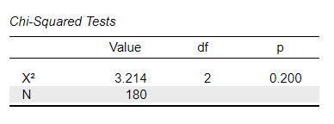
Test result: is it significant?
Look at the p value: is p < .05?
p = .200 is above p = .05, so the result is not significant, fail to reject the null hypothesis
= none of the categories significantly differ from the expected frequencies
(FYI: even though the output gives us a leading 0, we drop it and just write .200)

Slide 51
Interpretation
This means we fail to reject our null hypothesis and conclude that there is no evidence of significant differences in frequencies of streaming platforms, depending on location
As p = .200, the probability of observing this result if the H₀ were true is 20%.
Non-significant results mean the data are consistent (or compatible) with H₀, but this doesn’t prove H₀ is true - there may still be an effect that we didn’t detect?
If it were significant, you can look at post-hoc comparisons – tick ‘Residuals – Standardised’ to see which pair of categories/comparisons are significantly different or driving the effect. A residual > 1.96 is significant at p < .05

Slide 52
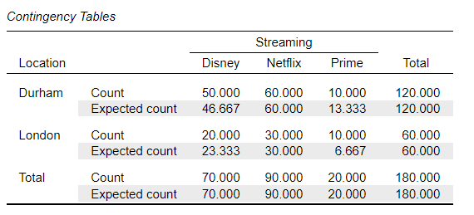
Interpretation
When you have a non-significant result, you don’t report anything further…you don’t do any comparisons or further analysis (e.g. no post-hoc comparisons)
But you can still look at the descriptives for context and report them if you want to / some people do) – it’s good to check your analysis result ‘makes sense’
(Similar observed vs expected values)

Slide 53
Write up Chi-square test
χ² (df, N = XX) = XX.XX, p = .XXX
State the test statistic test you calculated
df = degrees of freedom. Optional: N = num. of participants
Calculated test statistic value
The associated significance
(p value)
Here, it’s chi-square so use χ²
In the output table or calculate. Since N is optional, we write “N = “
This is the actual χ² value that you calculate (2 decimal places)
Report the EXACT p value to 3 decimal places (e.g., p = .042 OR p < .001)
This is APA standards, and very important! Please note:
Where I have put spaces
How many decimal places
Notice p and Chi-square is in Italics
If your p value output says .000, write p < .001
No leading zeros so p = .444 instead of p = 0.444

Slide 54
Example write up: Goodness-of-fit Chi-square test
A Chi-square goodness-of-fit test was conducted to determine whether preferences for three streaming platforms (Prime, Disney+, Netflix) matched the expected frequencies. There was a significant difference between people’s streaming platform preferences compared to expected frequencies, χ² (2, N = 180) = 43.33, p < .001.
Specifically, people preferred Netflix more than expected, while Disney+ and Prime were preferred less than expected. These findings suggest that individuals favoured Netflix compared to the other platforms.
(you can also report the observed/expected values here in parentheses if it’s not presented in a table)

Slide 55
Example write up: Chi-square test of association
A chi-square test of association was conducted to examine the relationship between participants preferred streaming platform (three levels: Prime, Disney+, Netflix) and their location (two levels: Durham and London).
The observed frequencies and expected frequencies were compared across the two locations and three streaming platforms.
The results indicated no significant association between location and streaming platform preference (χ² (2, N = 180) = 3.21, p = .200). This suggests there were no differences in streaming platform preferences based on location.

Slide 56

Online Content!
Run your own Chi-squared tests
Watch and follow along in JASP
Using the ‘How to’ in JASP videos

